Slide 1

windows phone 7 и windows 8: вместе веселее
краковецкий александр
microsoft regional director, mvp
devrain solutions

Slide 2
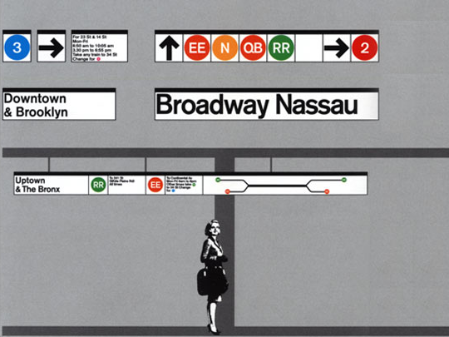
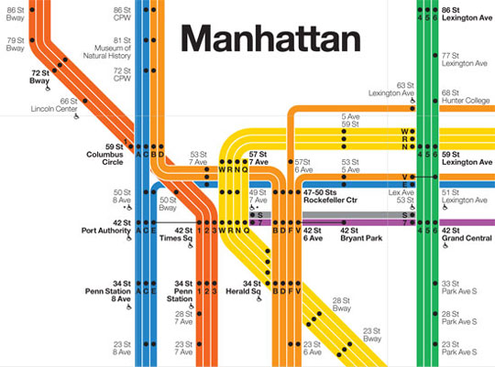
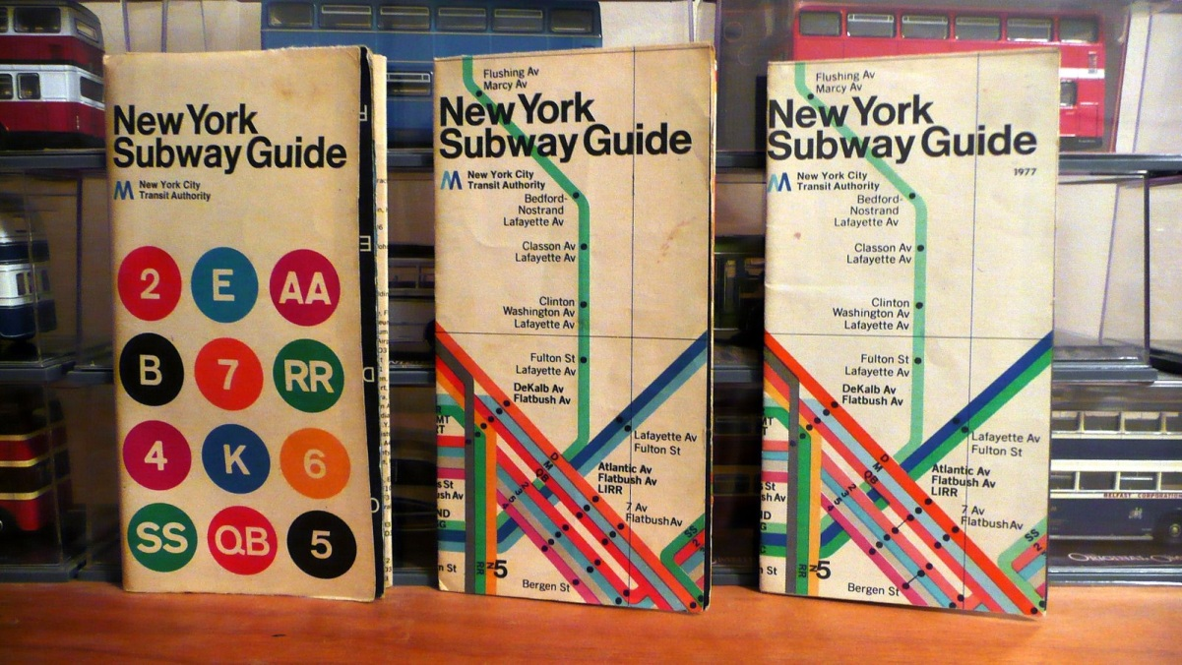

metro design language

Slide 3

ETRO

Slide 4
key principles
Light, Clean, Open and Fast
Content, not Chrome
Typography
Motion
Authentically Digital

Slide 5

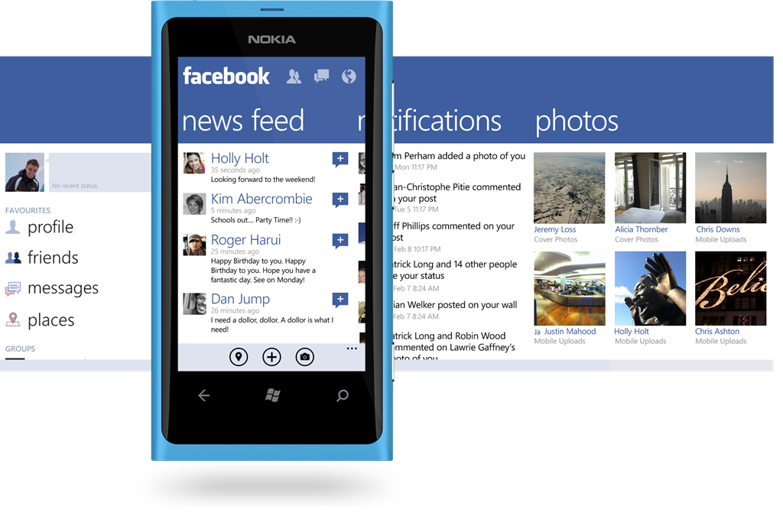
but metro first!

Slide 6
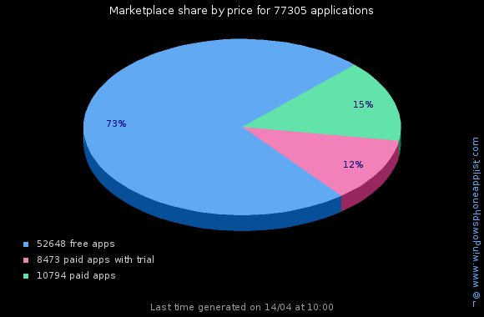
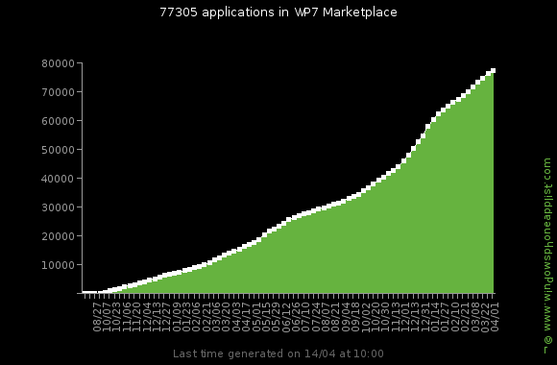
applications

Slide 7
stats and facts
Nokia sold 2 million units in Q1 2012;
Windows Phone 7 Now Outselling Symbian In The UK;
Windows Phone has 7% market share in Norway;
Lumia 800 represents 87% of all European Windows Phone 7 device sales;
Nokia Lumia 900 – best seller in Amazon’s Cell Phones With Service Plan top list;
250k of Nokia Lumia were sold in Russia in Q1 2012;
In Ukraine Nokia started selling phones at 29 of March;
Overall market share is approx. 4%.

Slide 8









windows phone 7 platform
Runtime
Tools
Sensors
Media
Data
Location
Phone Emulator
Samples
Documentation
Phone
Xbox LIVE
Notifications
.NET Framework managed code sandbox
Guides
Community
Front-end
Packaging and Verification Tools
Cloud
Cloud services
Portal services
Notifications
App Deployment
Registration
Marketplace
Location
Identity
Feeds
Validation
MO and CC Billing
Social
Maps
Certification
Business Intelligence
Publishing
Update Management

Slide 9
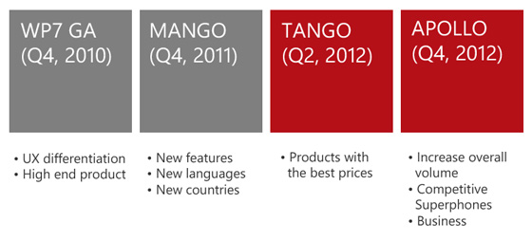
roadmap

Slide 10
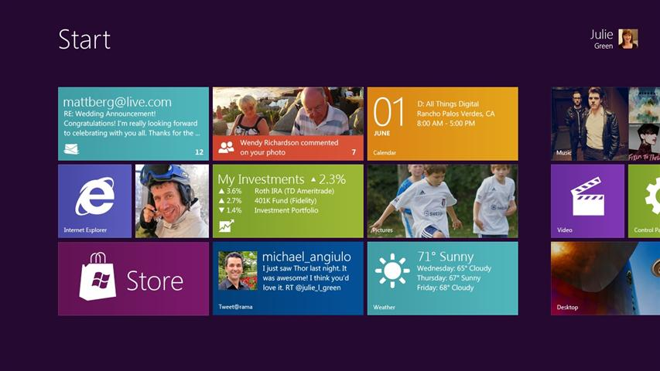
windows 8

Slide 11
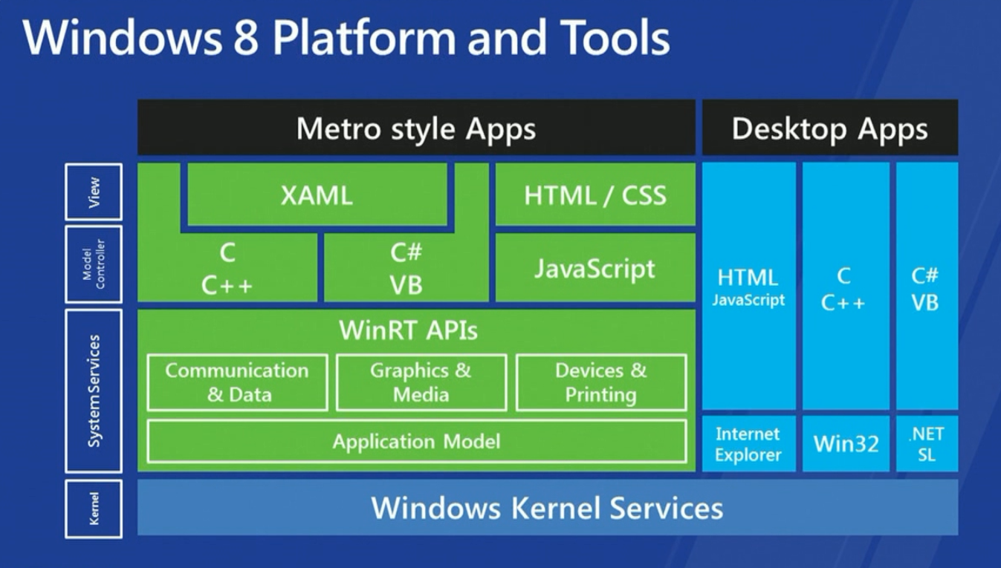
windows 8

Slide 12
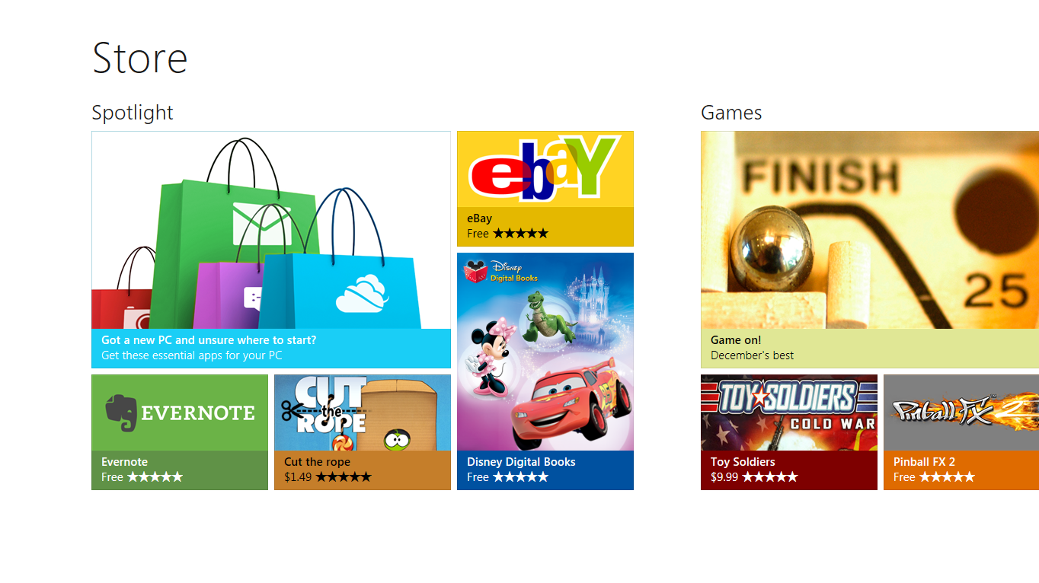
windows store

Slide 13
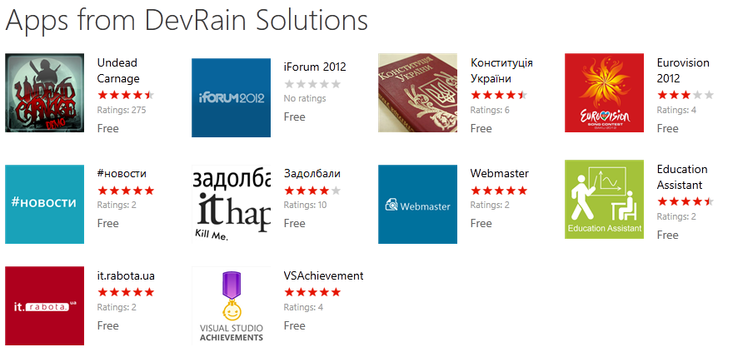
devrain solutions

Slide 14
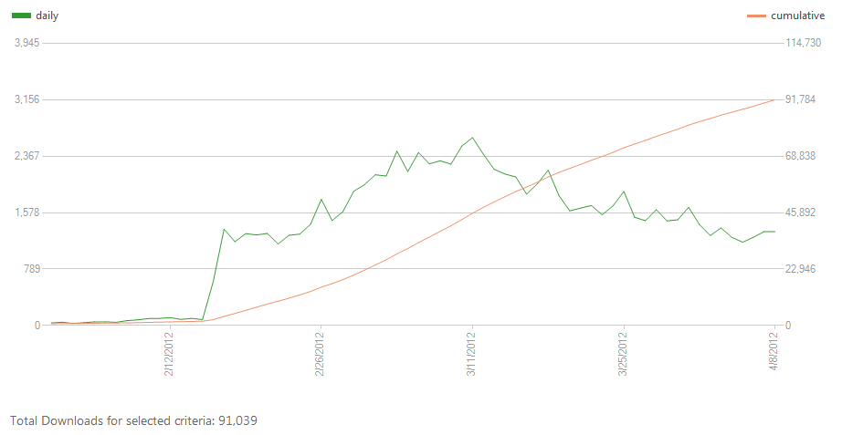
devrain solutions

Slide 15
references
wp7rocks.com
http://uxnext.org.ua
http://create.msdn.com
http://msdn.microsoft.com/en-us/library/ff637515(VS.92).aspx
http://msdn.microsoft.com/ru-ru/hh923919

Slide 16
Thank you!
@wp7rocks_com
wp7rocks.com
devrain.com

